Slide 1
Remote Code Execution in restricted Windows environments

Slide 2

Foto ponente
Borja Merino Febrero
borja.merino@protonmail.com

Slide 3
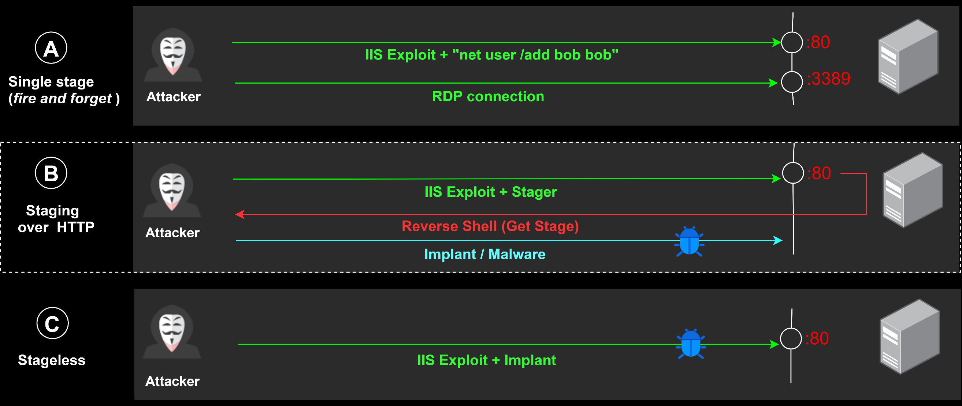
[0x00000001]> Let's get some context
REF: https://blog.rapid7.com/2015/03/25/stageless-meterpreter-payloads/ (OJ Reeves)

Slide 4
[0x00000002]> What is a Stager?
Shellcode responsible for fetching and executing the next Stage (malware/implant, intermediate stage).
They arise as a need due to the nature of certain exploits (space restrictions). However, they can be very useful even when we have the option to use a stageless approach ("Data Contraception“, “Profiling”).
They are usually hand-made to take the less space possible and to be used by a greater number of exploits. Compiling from languages such as C is another viable option, however, some issues have to be resolved: : PIC (Position-independent code), WinAPI resolution, stack strings, removing unneeded code, etc. *
Frameworks like Metasploit implement a large number of stagers that we can use to run our own payloads/implants
REF: http://www.exploit-monday.com/2013/08/writing-optimized-windows-shellcode-in-c.html

Slide 5
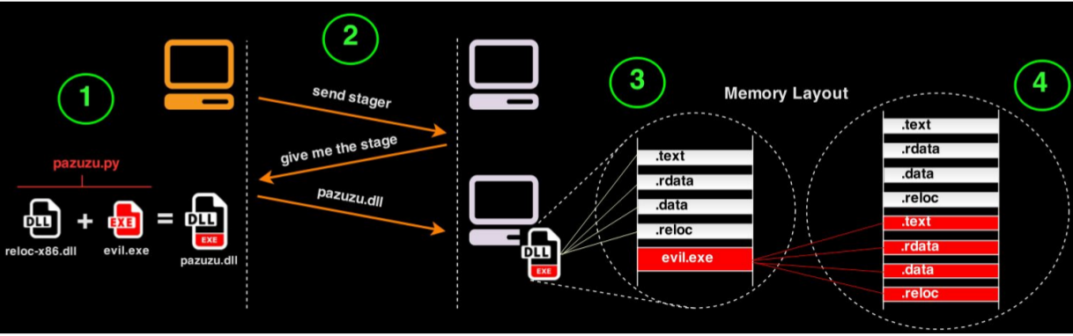
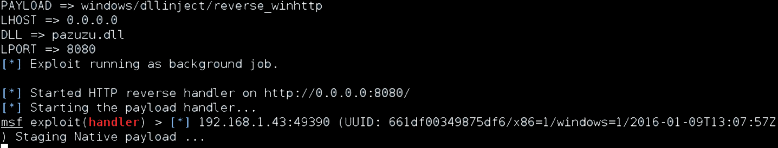
[0x00000003]> Pazuzu (reusing stagers for your implants)
REF: https://github.com/BorjaMerino/Pazuzu

Slide 6
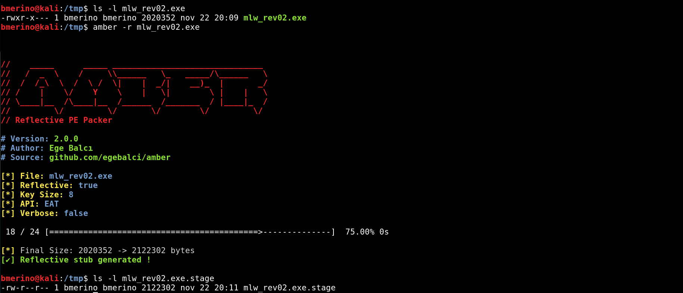
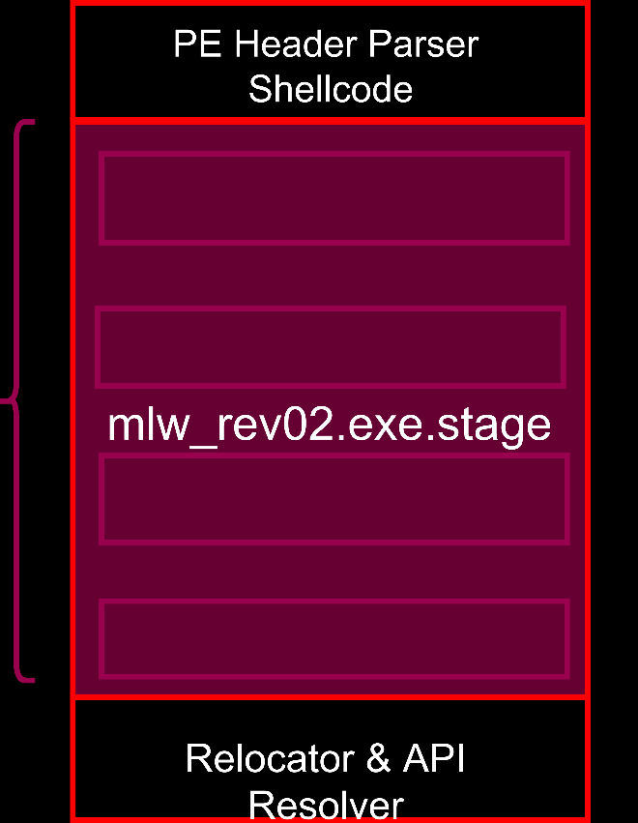
[0x00000004]> Amber (reusing stagers for your implants)
Memory Mapping
File
REF: https://github.com/EgeBalci/Amber (Ege Balcı)

Slide 7
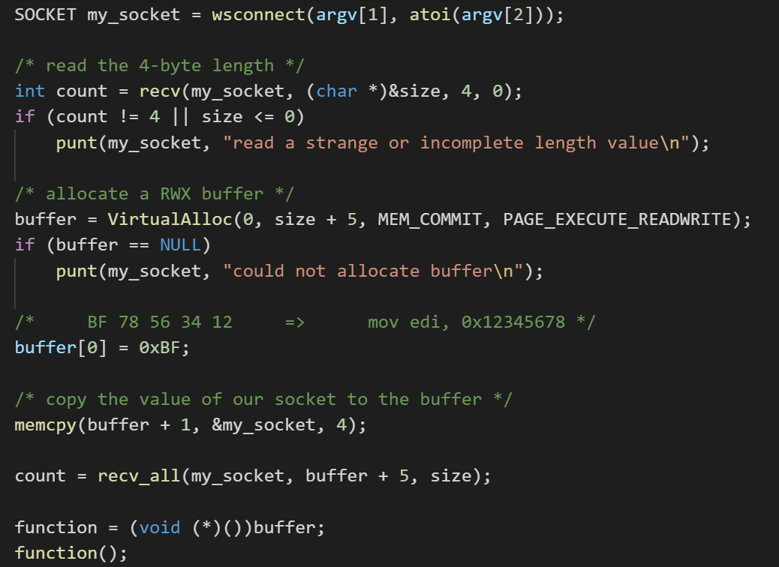
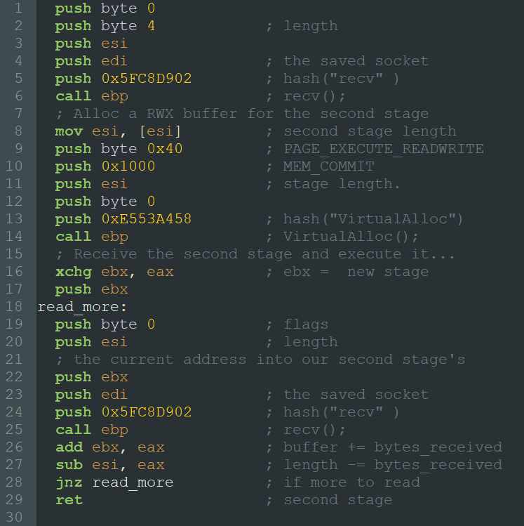
[0x00000005]> Stager skeleton
https://github.com/rsmudge/metasploit-loader/blob/master/src/main.c (Raphael Mudge)
Shellcode/windows/x86/src/block/block_recv.asm (Metasploit)

Slide 8
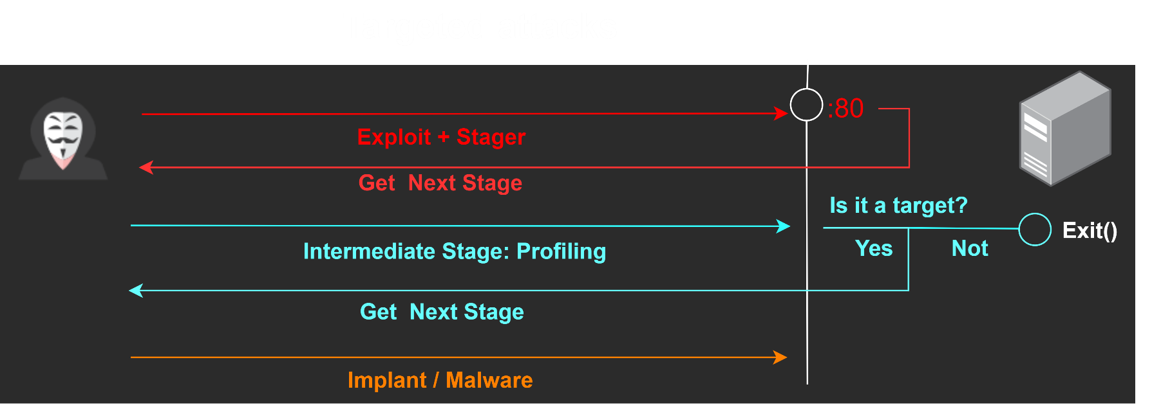
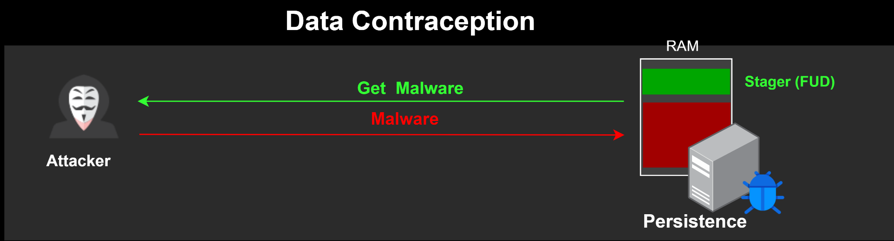
[0x00000006]> Other useful uses
Intermediate stage that checks if the objective is a potencial victim and if it meets certain criteria (domain?, language?, country? virtualized?, sandbox?)
Stager as a persistence method to recover and execute the implant in memory (no disk artifacts)
REF: http://phrack.org/issues/62/8.html (the grugq)

Slide 9
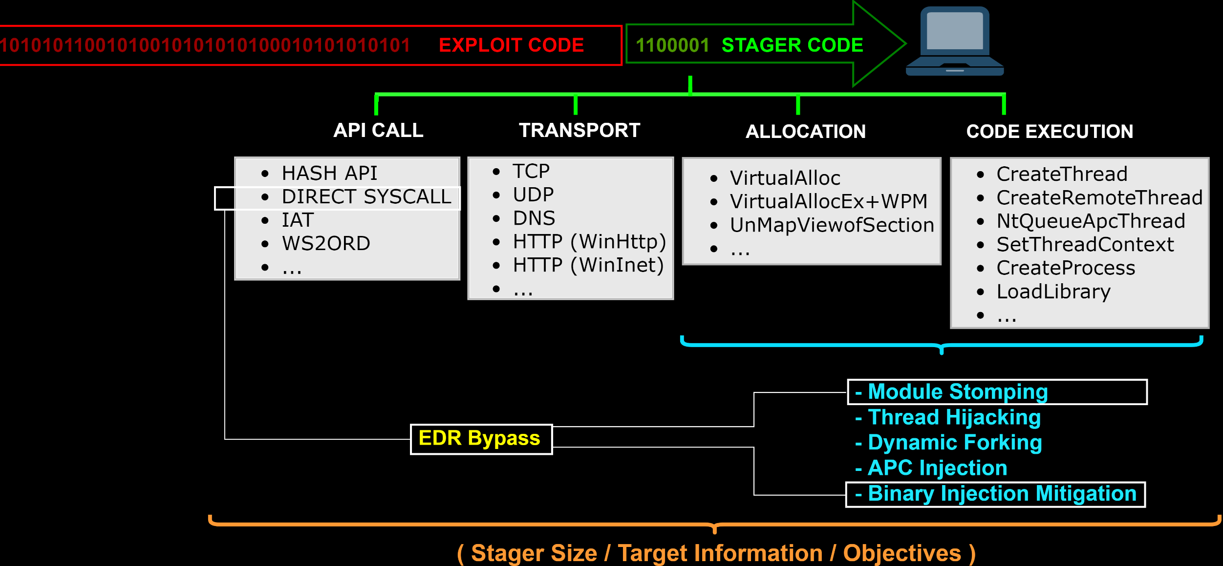
[0x00000007]> Stager building
*
REF: https://www.sekoia.fr/blog/microsoft-edge-binary-injection-mitigation-overview/

Slide 10
[0x00000008]> HTTP / HTTPS Transports
WinINet
Oriented to desktop applications
Sometimes WinINet is filtered by endpoint protection products
WinHTTP
Oriented to services (used by BITS and Windows Update)
Allows SSL validation/Certificate Pinning (Useful to avoid MiTM attacks)
Require “Keep-alive” (this is a problem with proxys HTTP 1.0). If there is enough room we can fallback to WinINet
*
REF: https://github.com/rapid7/metasploit-framework/wiki/The-ins-and-outs-of-HTTP-and-HTTPS-communications-in-Meterpreter-and-Metasploit-Stagers

Slide 11
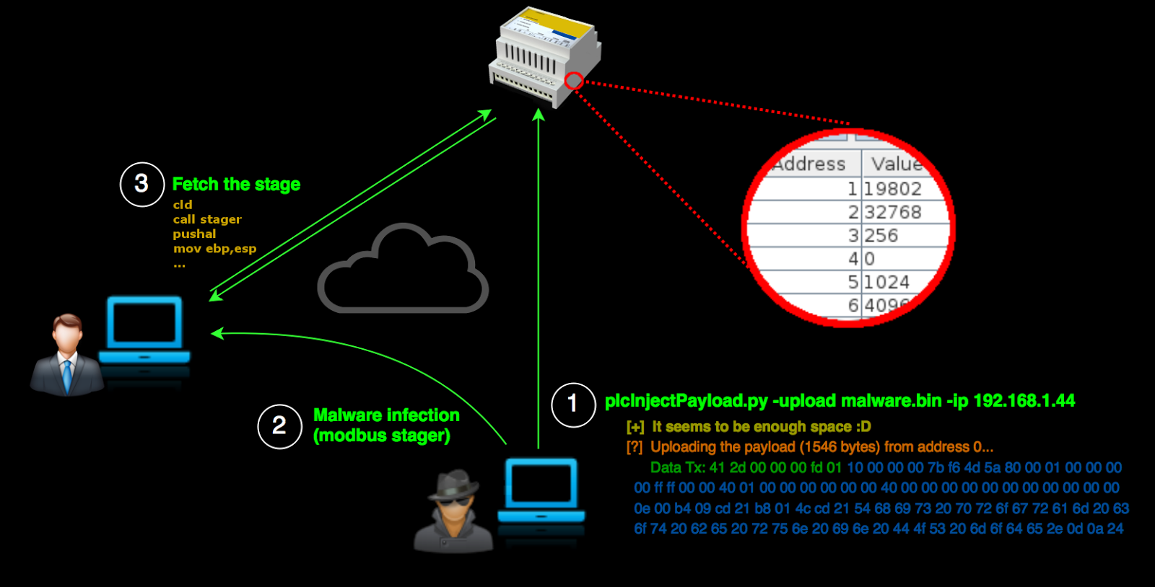
[0x00000009]> No protocol limitations: Modbus Stager
< 500 bytes
*
REF: https://www.shelliscoming.com/2016/12/modbus-stager-using-plcs-as.html

Slide 12
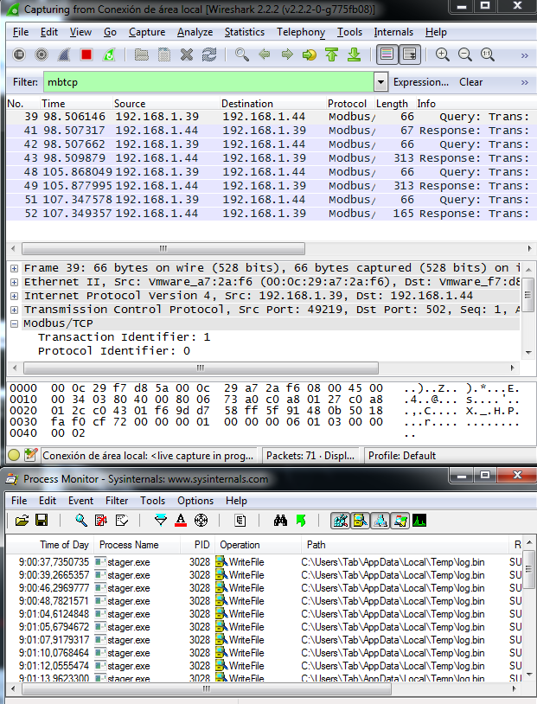
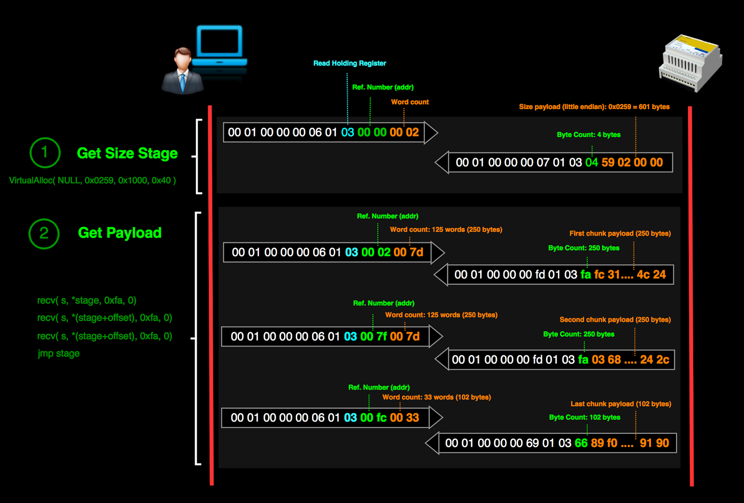
[0x0000000A]> No protocol limitations: Modbus Stager
REF: https://www.shelliscoming.com/2016/12/modbus-stager-using-plcs-as.html

Slide 13
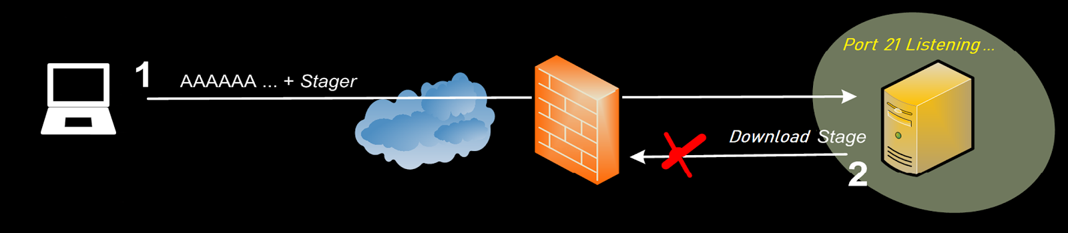
[0x0000000B]> Drawbacks of “universal” stagers
Useful Stagers:
Reverse Hop HTTP
Reverse TCP All Ports
DNS TXT Record Payload
Option: Socket hunting
Manual search
Rebinding ports *
Brute-force socket handles
FindTag (need recv() length argument)
FindPort (No PAT/NAT Immune)
Out-Of-Band Data *
Socket's lifetime *
IMP! Just useful when the process owns the socket (some services like DCOM, SMB, etc. are proxied through a central service and there is no socket to steal)
REF: http://phrack.org/issues/62/7.html

Slide 14
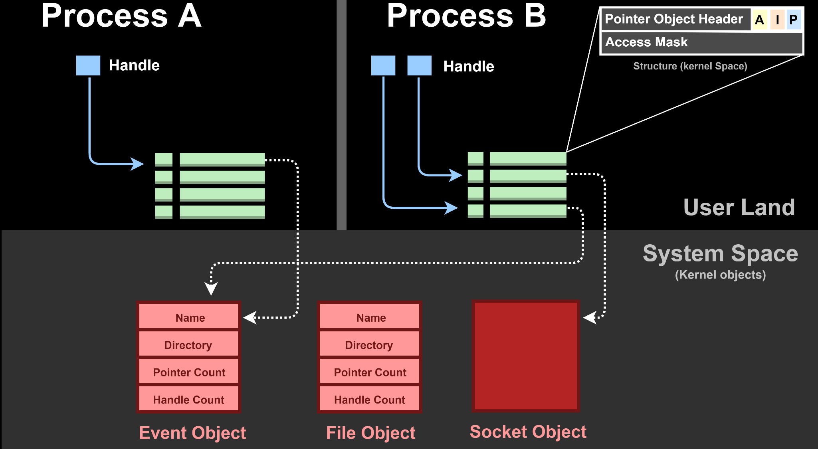


[0x0000000C]> Handles Table
REF: https://blogs.technet.microsoft.com/markrussinovich/2009/09/29/pushing-the-limits-of-windows-handles/

Slide 15
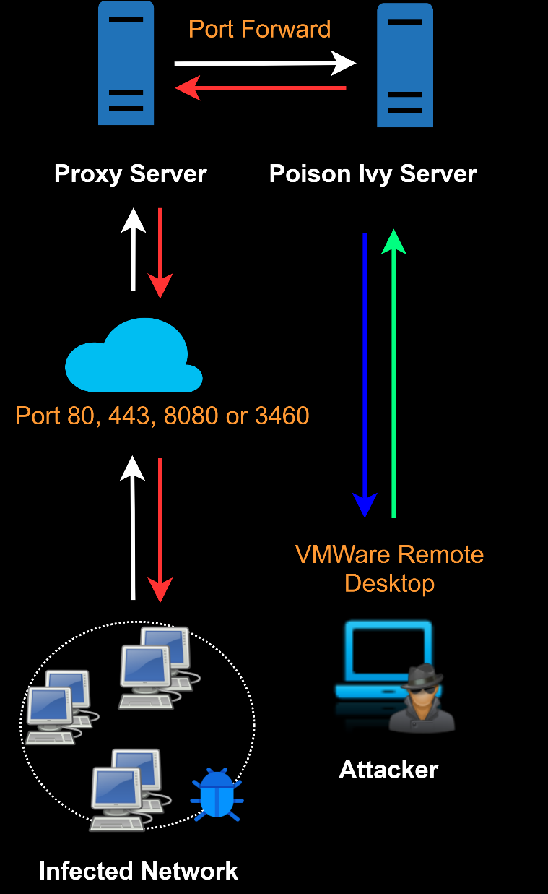
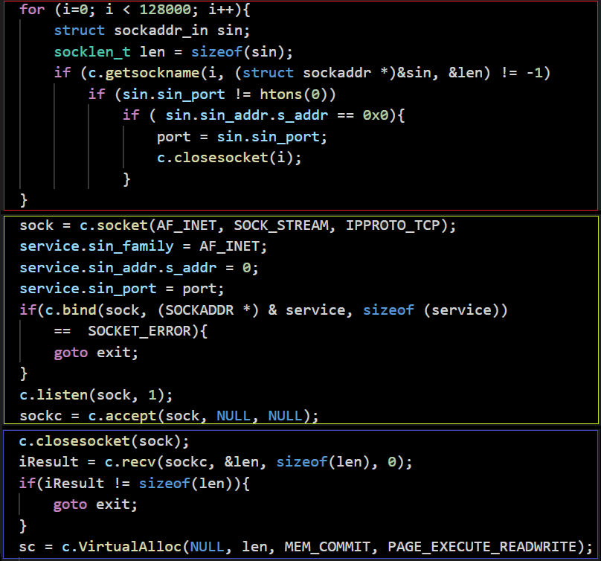
[0x0000000D]> APT1 Owned (Malware.lu CERT)
REF: https://malware.lu/assets/files/articles/RAP002_APT1_Technical_backstage.1.0.pdf

Slide 16
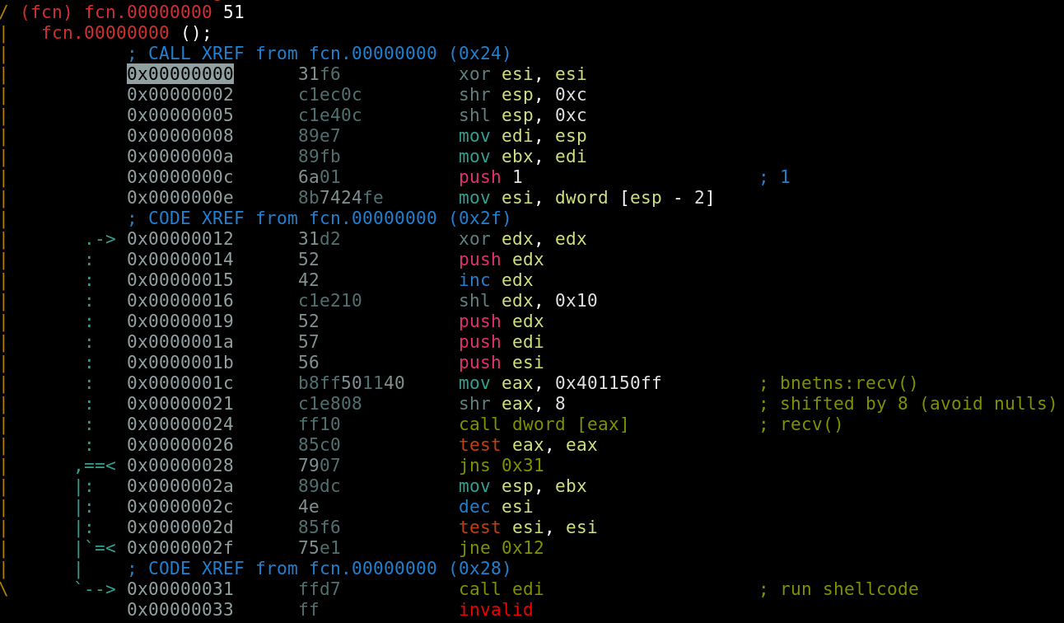
[0x0000000E]> Veritas Backup Exploit (H.D. Moore)
REF: https://github.com/rapid7/metasploit-framework/blob/master/modules/exploits/windows/backupexec/name_service.rb

Slide 17
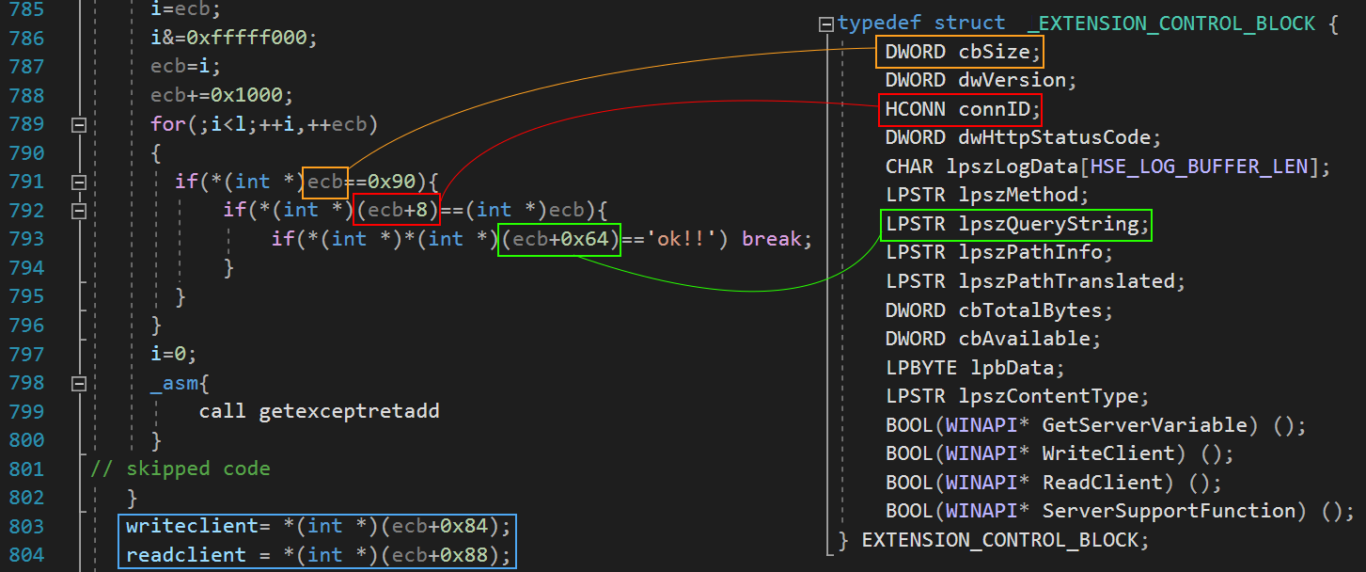
[0x0000000F]> Microsoft IIS 4.0/5.0 Exploit (Yuange)
https://www.exploit-db.com/exploits/21371
REF: https://cybersecpolitics.blogspot.com/2018/04/stealing-socket-for-policy-and-profit.html

Slide 18
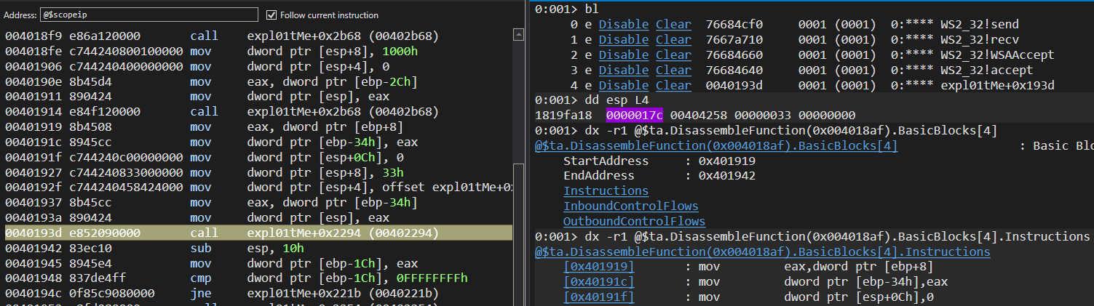
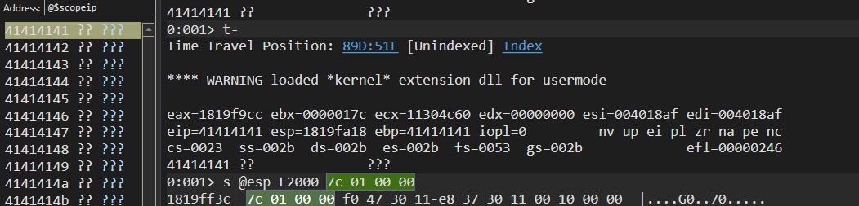
[0x00000010]> Socket Hunting (manual approach)
Windows Preview quite useful!
TTD (Time Travel Debugging)
Taint Analysis
Code-Flow / Coverage
REF: https://github.com/microsoft/WinDbg-Samples

Slide 19
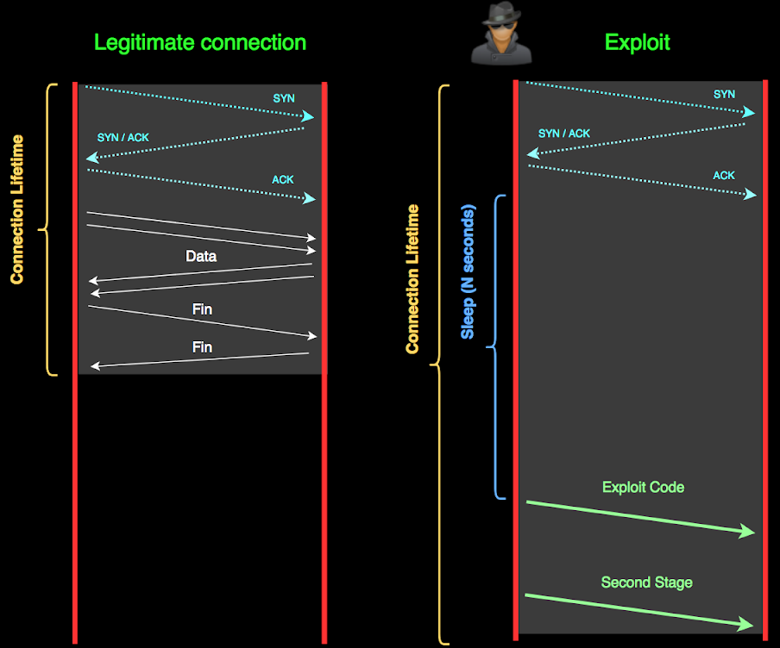
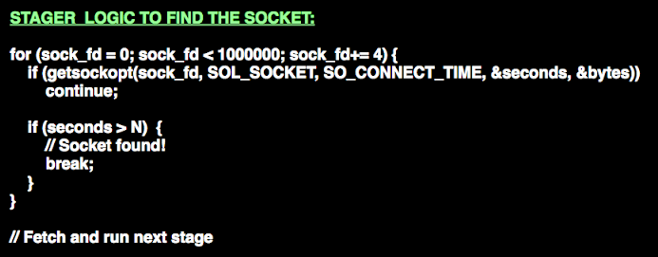
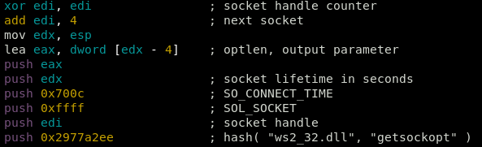

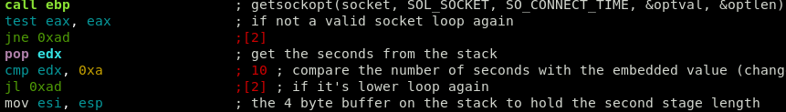
[0x00000011]> Shellcode based on socket's lifetime
REF: https://www.shelliscoming.com/2018/06/windows-reuse-shellcode-based-on.html

Slide 20
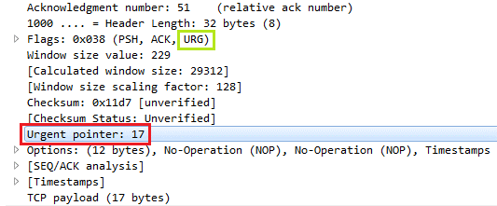
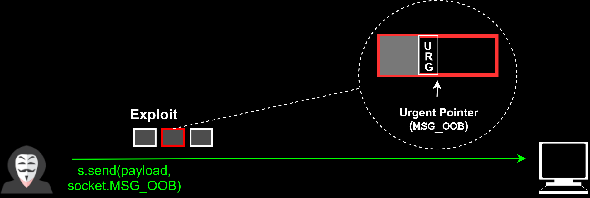
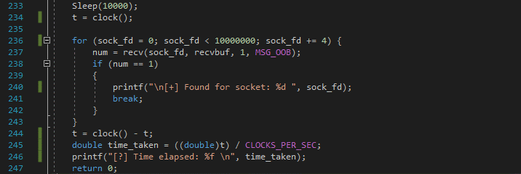
[0x00000012]> Shellcode based on Out Of Band data
TCP allows to send "OOB" data in the same channel as a way to indicate that some information in the stream should be processed as soon as possible by the recipient peer
REF: https://www.shelliscoming.com/2019/03/one-way-shellcode-for-firewall-evasion.html
https://bbs.eviloctal.com/thread-10143-1-8.html (Linux exploit: Autor bkbll)

Slide 21
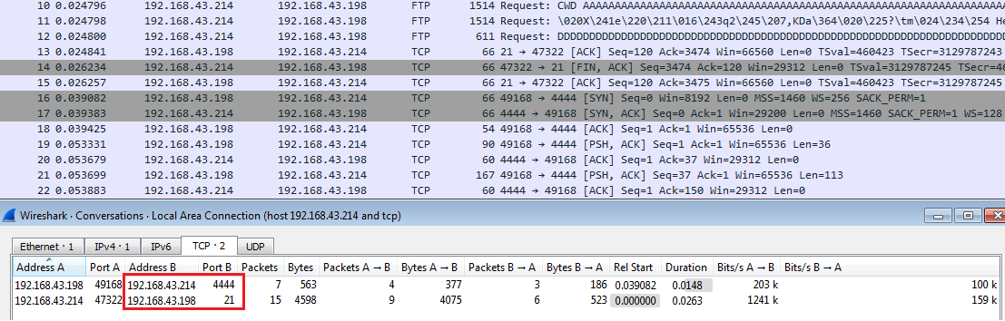
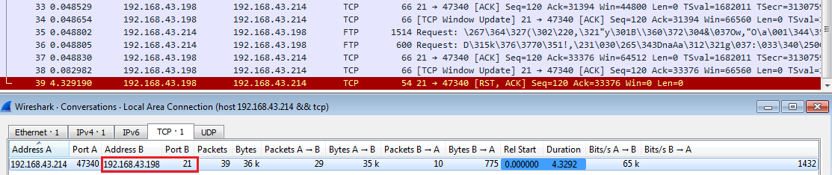
[0x00000013]> One-Way VS reverse shell
Standard
Reverse Shell
One-Way
Stager

Slide 22
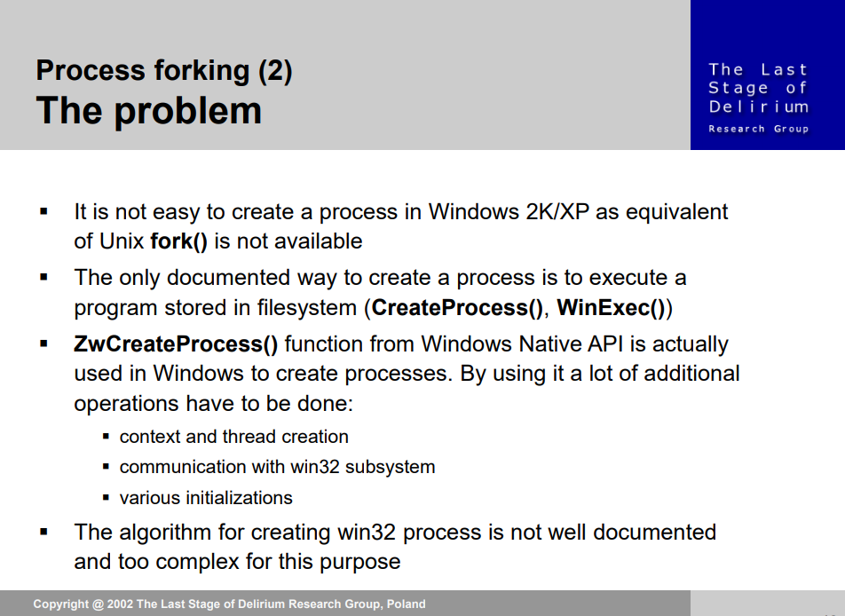
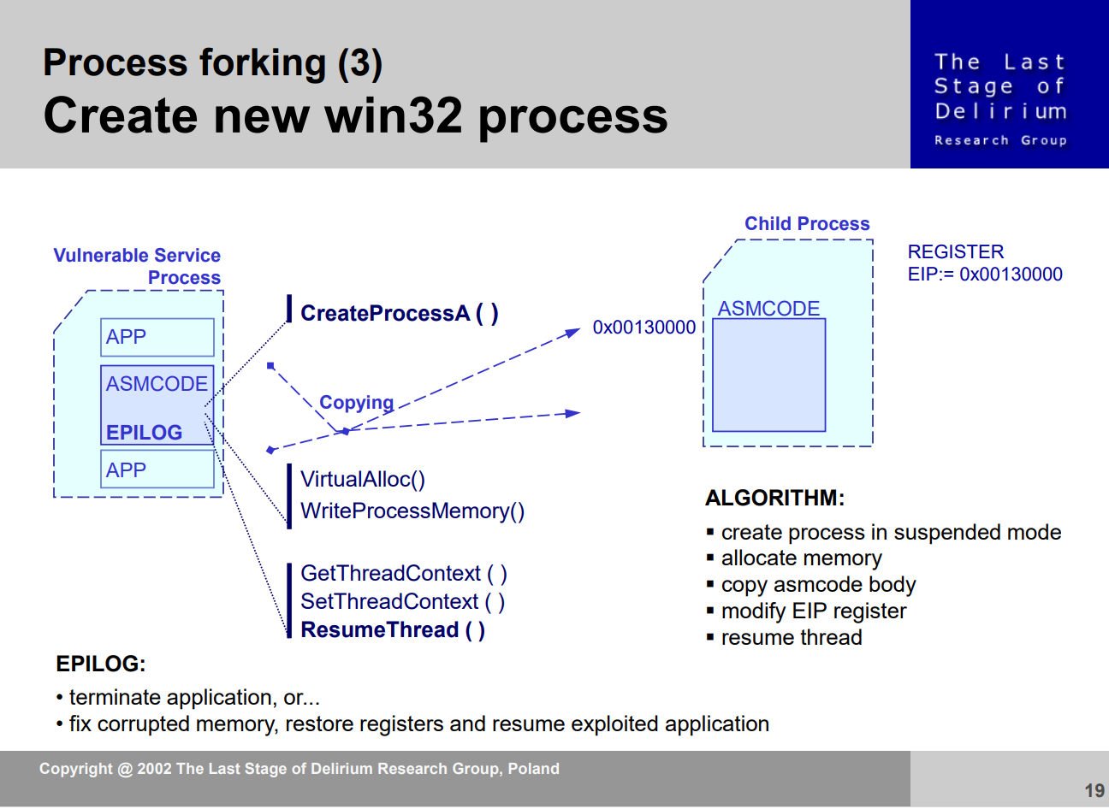
[0x00000014]> Rebinding approach
REF: https://web.archive.org/web/20161107193740/http://www.lsd-pl.net/winasm-slides.pdf

Slide 23
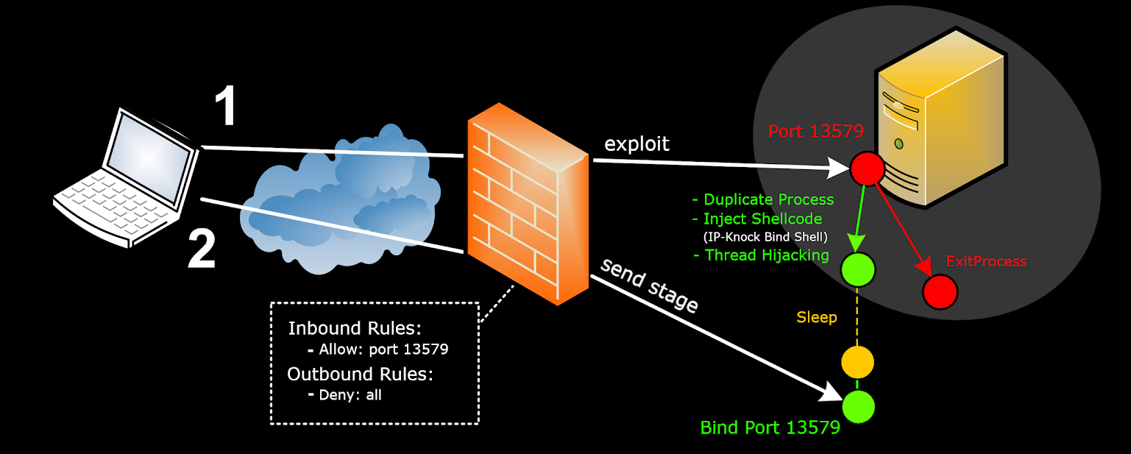
[0x00000015]> Rebind Port + ACL Shellcode
Process ’’Forking’’
REF: https://www.shelliscoming.com/2019/11/retro-shellcoding-for-current-threats.html
https://wj32.org/wp/2009/01/24/howto-get-the-command-line-of-processes/

Slide 24
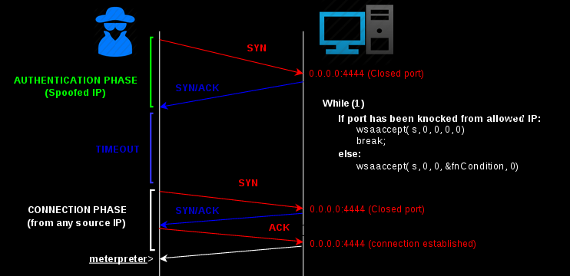
[0x00000016]> ACL Shellcode
REF: https://www.shelliscoming.com/2014/07/ip-knock-shellcode-spoofed-ip-as.html

Slide 25

[0x00000017]> One-Way-Shellcodes drawbacks
Sometimes the socket is not owned by the process.
Brute-force socket handles it's not a very reliable method (it doesn’t work in practice with many exploits).
Sometimes even if you get the socket handle your payload randomly die (i.e.: another thread tries to do something in your socket).
Most of the shellcodes are exploit specific (not universal).
They require a lot of effort and time.
Non serious experiment: Stager hunter (Honeypot with Frida)
Collection of papers/talks and techniques in Windows:
https://github.com/BorjaMerino/Windows-One-Way-Stagers

Slide 26


